Slide 1

Group 18 Email Subject Generation
Anupreksha Jain
Prashant Kataria
Rohini
Sridhar

Slide 2
Objective
Generate a succinct subject line from the body of an email.
To explore the use of Generative AI Language Models (LLMs) for generating compelling email subject lines.
To evaluate the effectiveness of different LLMs in creating subject lines that improve open rates.
To discuss the deployment process and challenges faced during implementation.

Slide 3
Model Evaluated
LLM | Framework | Model Type | Training Steps | Evaluation Method
Mistral | unsloth | 4 bit quantized | 60 | ROUGE Score
Llama3 | unsloth | 4 bit quantized | 60 | ROUGE Score
T5 | Transformer | Base model | 200 | ROUGE Score
Bart | Transformer | Base model | 200 | ROUGE Score

Slide 4
Inference Results
Email Body
﻿Please help summarize the provided email body and generate email subject The following reports have been waiting for your approval for more than 4 days. Please review. Owner: James W Reitmeyer Report Name: JReitmeyer 10/24/01 Days In Mgr. Queue: 5
Reference Ouptut:
Reports Awaiting Approval
Llama3 Model Output:
﻿Reports Waiting For Approval
Mistral Model Output:
﻿Approval Needed - Reports Waiting More Than Four Days
T5 Model Output:
Reports Waiting For Your Approval
Bart Model Output:
Expense Reports Awaiting Your Approval

Slide 5
Metrics
LLM | Rogue1 | Rogue2 | RougeL | RogueLSum
Mistral | 0.04 | 0.02 | 0.04 | 0.04
Llama3 | 0.04 | 0.02 | 0.04 | 0.04
T5 | 0.14 | 0.07 | 0.14 | 0.14
Bart | 0.27 | 0.13 | 0.25 | 0.25

Slide 6
Observations
Model Training:
To train on available limited hardware, used PEFT technique (LORA) on quantized versions of Llama 3 and Mistral models
Used Transformer framework to train the base versions of T5 and Bart models.
Email Subject Generation:
Both Generative and Seq2Seq models generated contextually correct email subjects.
Model Performance and Comparison:
Mistral and Llama 3 models generated synonyms of words, resulting in low Rouge scores.
Seq2Seq models picked up words directly from the email content, leading to high Rouge scores.
Bart and T5 models, both encoder-decoder types, outperformed Mistral and Llama 3 models.

Slide 7
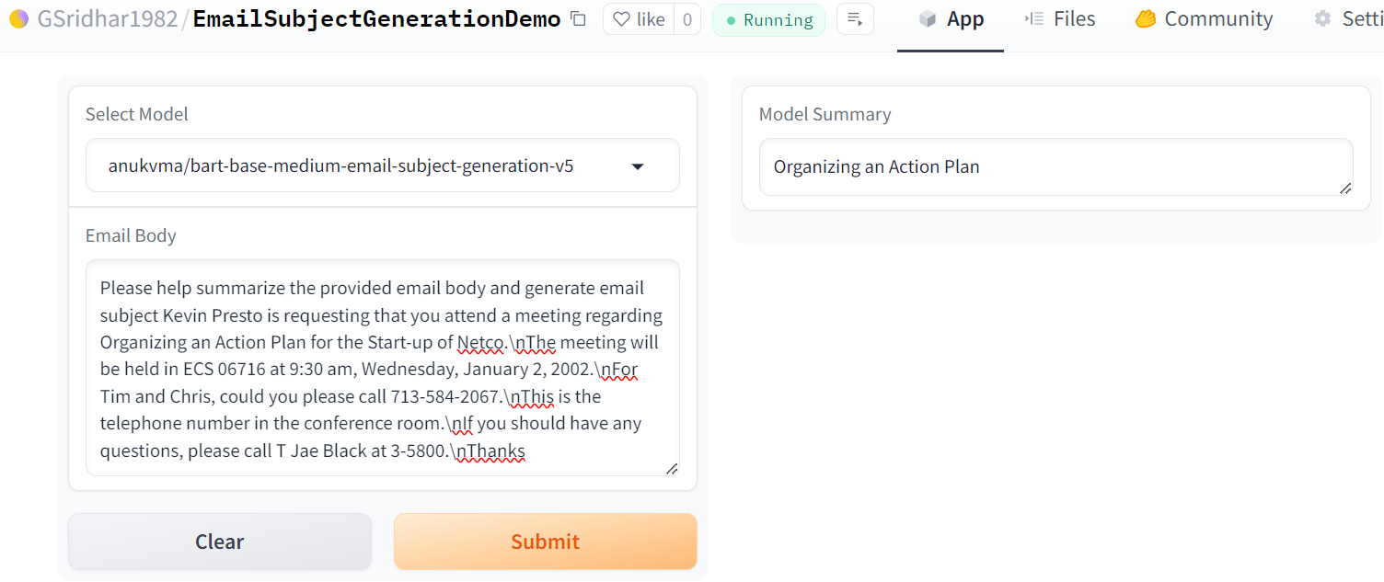
Demo
Gradio App:
https://huggingface.co/spaces/GSridhar1982/EmailSubjectGenerationDemo
FAST API:
https://anukvma-emailsubjectapi.hf.space/

